Slide 1
Predictive Machine Maintenance
Sulaiman Bah

Slide 2
TABLE OF CONTENTS
01
02
03
04
05
06
Problem Statement
Data Collection
Data Preprocessing
Modeling
Conclusion
Exploratory Analysis

Slide 3
Problem Statement
In many industrial settings, the reliability and optimal performance of machines are critical to maintaining smooth operation. The challenge lies in addressing unexpected machine failures and unplanned downtime, which leads to financial losses and operation disruption.
Objective is to develop a predictive maintenance model to anticipate and address potential machine failures before they occur. Creating a model which aims to leverage historical data to create a maintenance schedule to improve operation efficiency.

Slide 4
Data Collection
Milling Machine Dataset
Data Description
The Kaggle Dataset contains a synthetic dataset modeling a milling machine’s operation, designed to predictive maintenance application
Comprised of 10,000 data points
Represented by 14 features
  Product Quality
  Temperature
  Rotational speed
  Torque
  Tool Wear
  Machine Failure

Slide 5
Data Preprocessing
STEP 1
STEP 2
STEP 3
STEP 4
Handling missing value
Corresponding data types
Looking unique data
Dropping columns
STEP 5
Identifying categorical &numerical columns

Slide 6
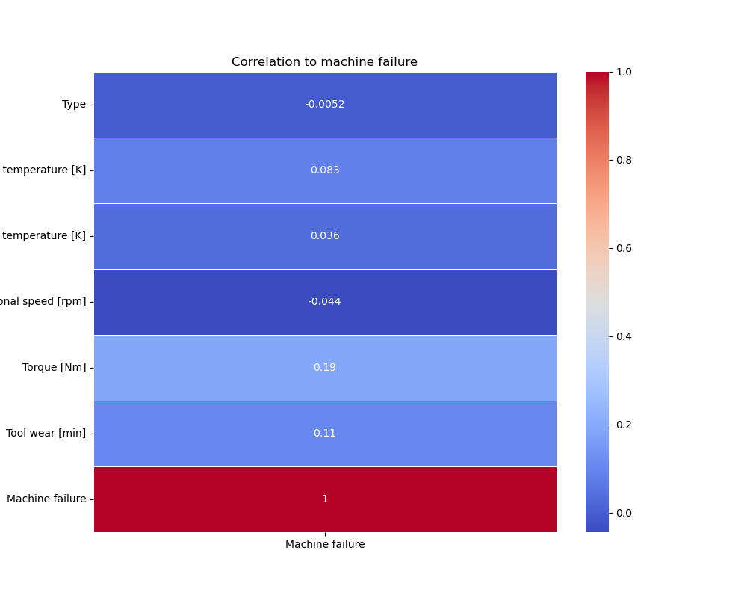
Exploratory Data Analysis
Correlation Heatmap
Checking different features and there correlation to the Machine failure.

Slide 7
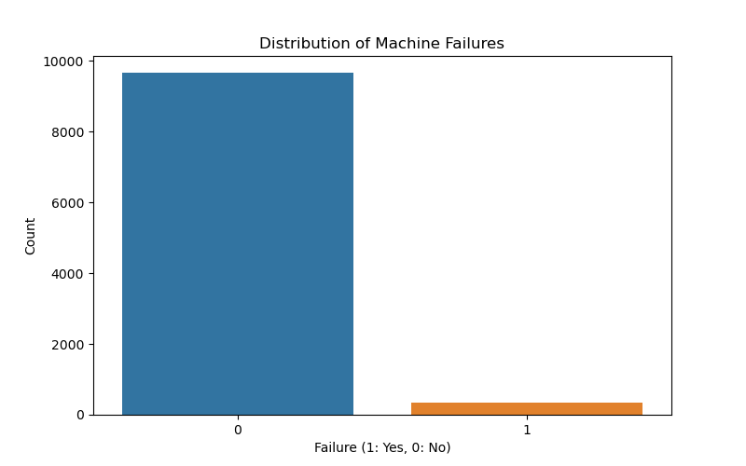
Exploratory Data Analysis
Unbalanced Data
No Failures : 9,661
Failures: 339
SATURN
Saturn is a gas giant and has several rings. It's composed mostly of hydrogen and helium. It’s the sixth planet from the Sun

Slide 8
Models
Logistic Regression
SMOTE Logistic Regression
Baseline Model without balanced Data
Train Score: 96.9%
Testing Score: 97.2%
Used SMOTE to balance Data
Train Score: 83.4%
Testing Score: 83.05%
Random Forest
Random Forest w/ XGBoost
Train Accuracy: 100%
Test Accuracy: 97.77%
Train Accuracy: 95.3%
Testing Accuracy: 94.7%

Slide 9
Models
Logistic Regression
SMOTE Logistic Regression
Baseline Model without balanced Data
Train Score: 96.9%
Testing Score: 97.2%
Used SMOTE to balance Data
Train Score: 83.4%
Testing Score: 83.05%
Random Forest
Random Forest w/ XGBoost
Train Accuracy: 100%
Test Accuracy: 97.77%
Train Accuracy: 95.3%
Testing Accuracy: 94.7%

Slide 10
Conclusion
Using the Random Forest model, we are able to create a predictive maintenance model which correctly identify a machine failure with a 97.77% accuracy.
The recommendations to better improve the accuracy, is to get more data since were limit to a synthetic dataset, add more features such as inspection/ maintenance schedule, runtime data, lifetime of machine counterparts.
Following those recommendations we would be able to automate the data, allowing us to create a app that would give out alerts for when preventative maintenance should be done.

Slide 11
THANKS!
Do you have any questions?

